Slide 1
ProMax Outbound
Call Tracking

Slide 2
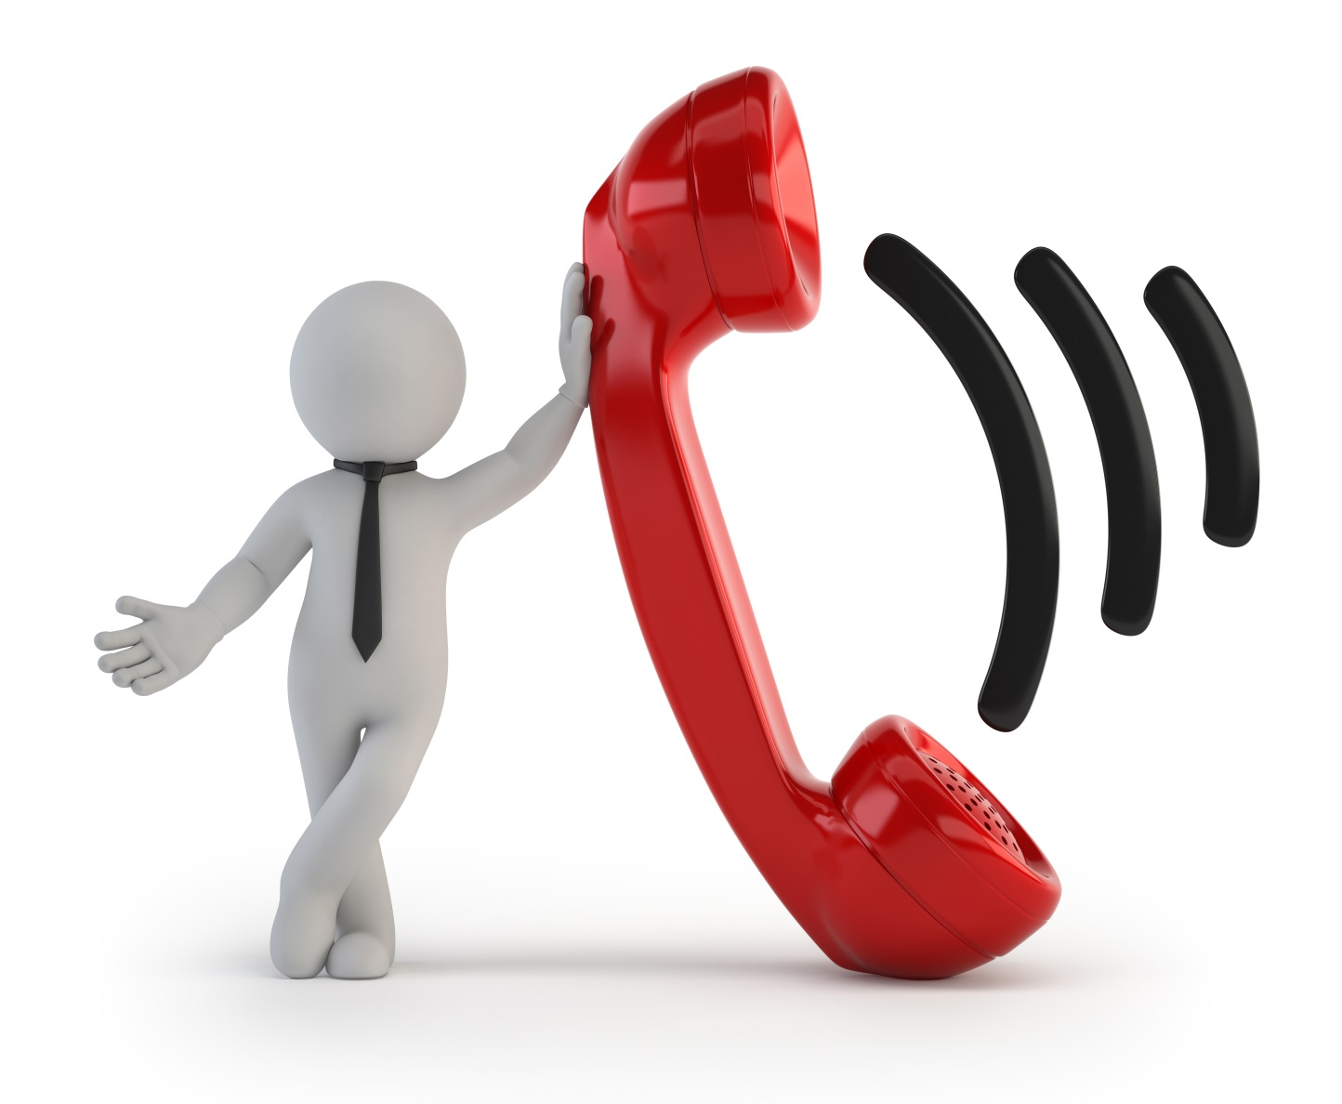
ProMax Outbound Call Tracking
Do you have any idea how many outbound calls your sales staff and BDC reps are making? What about the quality of those calls?
You spend a lot of money generating leads. If your reps aren’t following up or making quality calls you could be squandering sales opportunities.

Slide 3
MAXIMIZE PERFORMANCE –
ProMax’s Outbound Call Tracking will allow you to improve sales performance and accountability.
Through ProMax, all outgoing calls will be tracked, managed, and can be recorded allowing you to effectively measure your most valuable resource – potential new customers.
No more wondering if your reps are actually making their calls or the quality of their calls. Now you will know for sure!

Slide 4
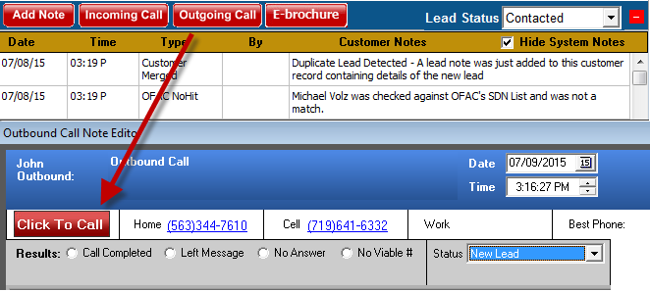
Simplify your calling process
With one click of the button in ProMax, outbound sales calls can be initiated straight from the customer workscreen, daily workplan or phone scripts, therefore eliminating the need to manually dial the customer’s number.
It couldn’t be any easier or more efficient!

Slide 5
Make calls from anywhere, not just from within ProMax
Making calls isn’t limited to only being done from within ProMax. Yes, the ‘Click to Call’ feature within ProMax is great but we realize your reps won’t be in front of ProMax all day long.
Your reps can make calls from any phone, anywhere, and we can track it as normal.

Slide 6
ProMax integration allows for efficient and streamlined call management
Every outbound call made will automatically be added to the customer workscreen in your ProMax system. Within the workscreen, you will be able to view the date & time the call was made, who placed the call and the duration of the call.
In addition, the audio file is also provided so you can listen to the call right from the workscreen.
Call details
Call recording
Customer Info
Maintain Staff Accountability
Take advantage of the information you are given. With the call data being integrated directly into ProMax ,the days of assuming or hoping your reps made their calls is now a thing of the past.

Slide 7
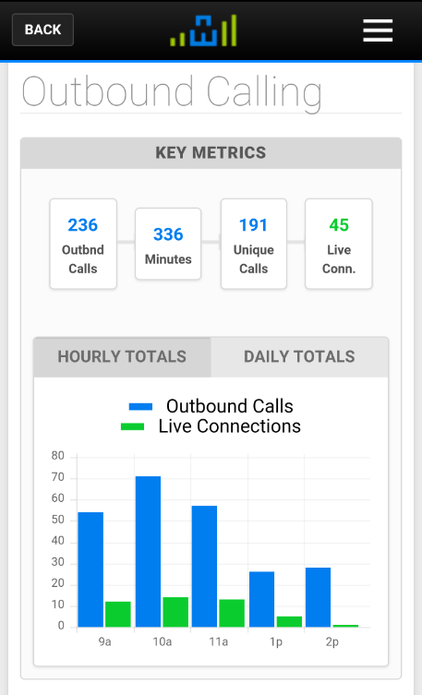
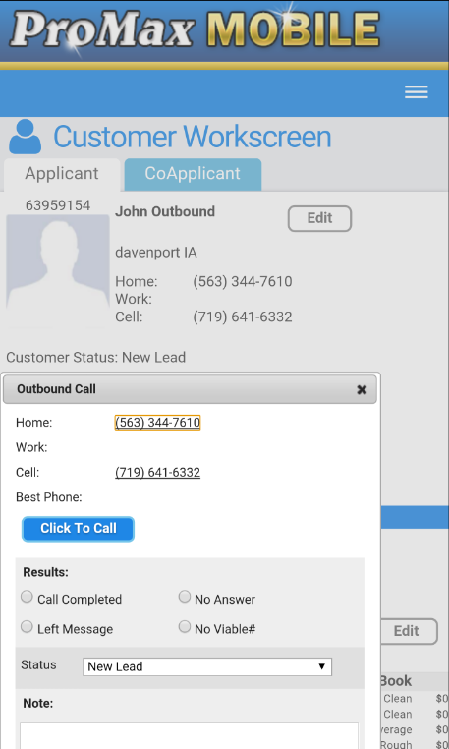
ProMax Mobile integration
The days of working only when you are at your desk are a thing of the past. With the help of ProMax Mobile, the interface is fully accessible anytime from anywhere. Place calls directly through ProMax Mobile to your customers.
The responsive website gives you easy access to place calls to your customers as well as supplying real time analytics and call data directly from your mobile device.

Slide 8
Audio File Sharing
Commend when a rep excels and Coach where improvement is needed
Studies show when a person is aware they are being observed their performance will improve. This is also true in terms of handling sales calls.
With the ability to share audio files with your management team or directly with the staff themselves, you are opening new opportunities through coaching. Sharing best practices will improve how calls are handled.

Slide 9
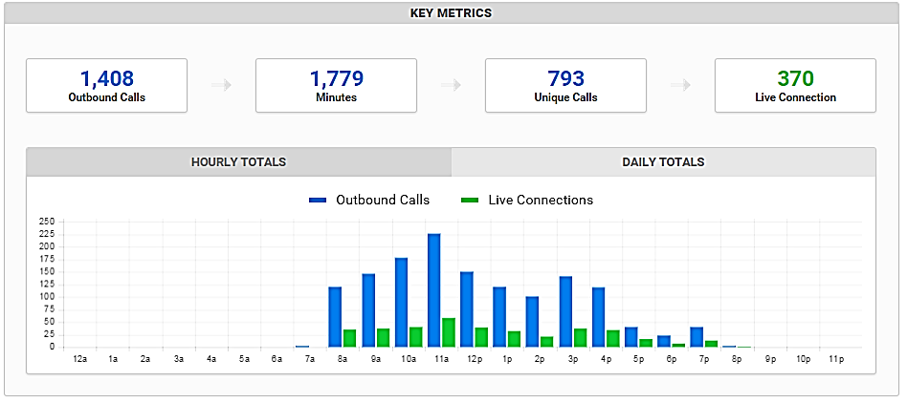
Outbound Call Analytics
Advanced reporting provides you with the essential data needed to effectively manage & measure your outbound call activity.
By individual sales rep or BDC reps
- Compare your sales team members with one another for performance tracking
By how many calls were made
- See the total amount of calls made per individual rep as well as an entire group
By date and time
- Determine your most productive or least productive times
By how many calls were answered
- In addition to total amount calls made know how many resulted in a live conversation

Slide 10
Live Conversation Metrics
Which is more important? The amount of calls that were made or the number of quality conversations that took place?
Our Outbound Call Tracking system will show you with great accuracy which calls resulted in a live conversation with the intended party. After all, isn’t connecting with the intended party your top priority?

Slide 11
With features like…
Click to Call
ProMax Integration
Audio File Sharing
Live Conversation Metrics
Extensive Reporting
…ProMax’s Outbound Call Tracking will keep your sales team accountable and your managers informed, which enables you to improve the quality of your calls equating to more sales and returning customers.

Slide 12
Improve sales performance and accountability with
ProMax Outbound Call Tracking
Dealer Marketing Services, Inc.
Makers of ProMax Unlimited
563-344-7610

